Slide 1
Energy storage system

Slide 2
Battery Technology
Cell is a device which converts chemical energy into electrical energy.
A cell forms a single unit and generates less energy. Higher voltage can be achieved by coupling number of cells.
Definition: A Battery is a device that consists of two or more galvanic cells connected in series or parallel or both, which converts chemical energy into electrical energy through redox reactions.
Battery can store Chemical energy in the form of active material and on demand convert it into electrical energy through electrochemical redox reaction.

Slide 3
The size of a battery ranges from a fraction of a cubic centimetre to several cubic metres. Batteries are used in calculators, digital watches, pace makers, hearing aids, portable computers, electronically controlled cameras, car engines, stand-by power supplis, emergency lighting and electroplating, telecommunication and military and space applications.
A battery is designed and manufactured for a specific performance such as, to power a torch, to start a car engine, to supply emergency power to the hospitals and to generate a very precise voltage to maintain heartbeats.

Slide 4
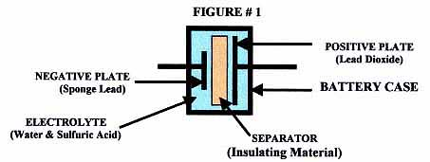
Components of the batteries:
(1) Anode or negative electrode
(2) Cathode or positive electrode
(3) Electrolyte
(4) Separator

Slide 5
The major components of a battery are:
(1)Anode or negative electrode: It releases electrons to the external circuit by undergoing oxidation.
(2)Cathode or positive electrode: It accepts electrons from the external circuit and the active material undergo reduction reaction.
(3)Electrolyte: A solution of an acid, alkali or salt having higher ionic conductivity is commonly used as electrolyte. Electrolyte provides medium for transfer of ions between the anode and cathode.
(4)Separator: The material used to separate anode and cathode in a battery to prevent internal short circuiting. It is permeable to the electrolyte and maintains the desired ionic conductivity.
Example: cellulose, vinyl polymers, cellophane etc.

Slide 6
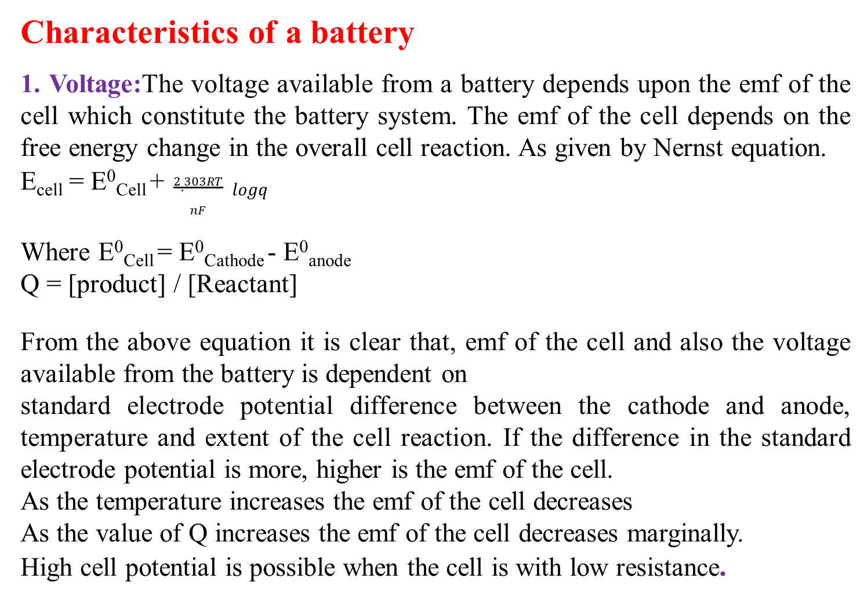
Characteristics of a battery
1. Voltage:The voltage available from a battery depends upon the emf of the cell which constitute the battery system. The emf of the cell depends on the free energy change in the overall cell reaction. As given by Nernst equation.
E_{cell} = E⁰_{Cell} + $\frac{2.303RT}{nF} logq$
Where E⁰_{Cell} = E⁰_{Cathode} - E⁰_{anode}
Q = [product] / [Reactant]
From the above equation it is clear that, emf of the cell and also the voltage available from the battery is dependent on
standard electrode potential difference between the cathode and anode, temperature and extent of the cell reaction. If the difference in the standard electrode potential is more, higher is the emf of the cell.
As the temperature increases the emf of the cell decreases
As the value of Q increases the emf of the cell decreases marginally.
High cell potential is possible when the cell is with low resistance.

Slide 7
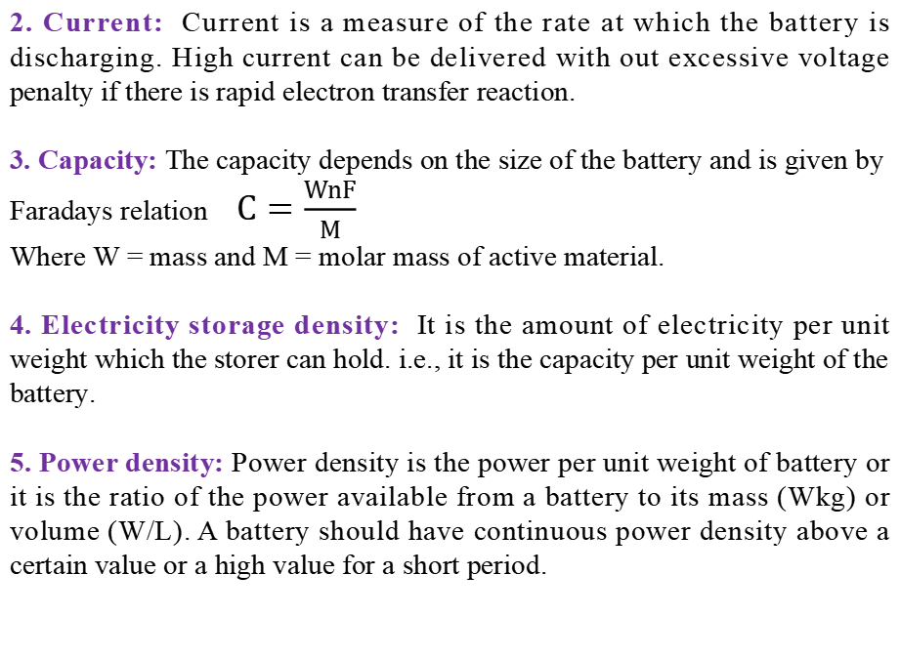
2. Current: Current is a measure of the rate at which the battery is discharging. High current can be delivered with out excessive voltage penalty if there is rapid electron transfer reaction.
3. Capacity: The capacity depends on the size of the battery and is given by Faradays relation $C=\frac{WnF}{M}$
Where W = mass and M = molar mass of active material.
4. Electricity storage density: It is the amount of electricity per unit weight which the storer can hold. i.e., it is the capacity per unit weight of the battery.
5. Power density: Power density is the power per unit weight of battery or it is the ratio of the power available from a battery to its mass (Wkg) or volume (W/L). A battery should have continuous power density above a certain value or a high value for a short period.

Slide 8
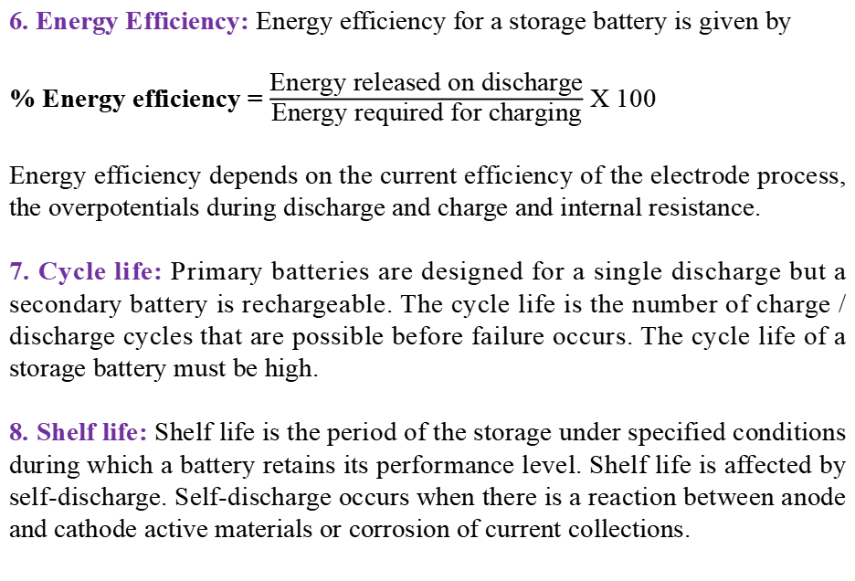
6. Energy Efficiency: Energy efficiency for a storage battery is given by
% Energy efficiency = $\frac{\text{Energy} \text{released} \text{on} \text{discharge}}{\text{Energy} \text{required} \text{for} \text{charging}}$ X 100
Energy efficiency depends on the current efficiency of the electrode process, the overpotentials during discharge and charge and internal resistance.
7. Cycle life: Primary batteries are designed for a single discharge but a secondary battery is rechargeable. The cycle life is the number of charge / discharge cycles that are possible before failure occurs. The cycle life of a storage battery must be high.
8. Shelf life: Shelf life is the period of the storage under specified conditions during which a battery retains its performance level. Shelf life is affected by self-discharge. Self-discharge occurs when there is a reaction between anode and cathode active materials or corrosion of current collections.

Slide 9
Classification of batteries
Batteries are classified as
Primary batteries
Secondary batteries
Reserve batteries
1. Primary batteries:
They are irreversible.
They are not rechargeable and once discharged they have no further electrical use.
Example: Zn-MnO₂ Battery, Li-MnO₂ batteries, etc.

Slide 10
2. Secondary batteries:
In secondary batteries the cell reactions are reversible.
They are also called as storage batteries.
The discharged cell can be recharged by passing current through it in the direction opposite to that of discharge current.
Example: Lead storage batteries, Nickel –Cadmium battery, etc.
3. Reserve batteries:
One of the components in the reserve batteries is stored separately and is incorporated into the battery when required.
Usually electrolyte is stored separately.
Example: Mg battery activated by water, Zn-Ag₂O batteries

Slide 11
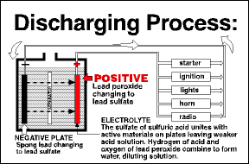
Operation of battery
Discharging

Slide 12
Discharge occurs when the battery is connected to an external circuit and the circuit is closed.
During discharge, the anode undergoes oxidation to form cations and releases electrons.
The electrons flow from the anode to the cathode through the external circuit
At the cathode the electrons are accepted and the active species at the cathode compartment is reduced to metal releasing the anions.
The anions and cations formed at the respective electrodes move across the separator to maintain electroneutrality and to complete the electric circuit.
The reaction during discharge are
M_{a} → M_{a}^{n+} + ne ------ anode
M_{e}^{a+}y^{n-} + ne → M_{e} + ny⁻ ------- cathode

Slide 13
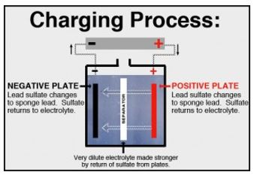
Charging

Slide 14
During recharge, the current flow is reversed with the aid of a DC power supply .
The negative terminal of the power supply is connected to the negative electrode of the battery and the positive terminal of battery to positive electrode.
At the anode the active species is reduced to metal and at cathode, oxidation takes place forming the active species.
Thus, during recharge the positive electrode is anode and the negative electrode is cathode.
The electrode reactions occurring during recharge are the reverse of those occurring during discharge.
M_{e-} + nY⁻ → M_{e}^{a+}y^{a-} + ne ---------- cathode
M_{ae}^{n+} + ne → M_{a} ------- anode

Slide 15
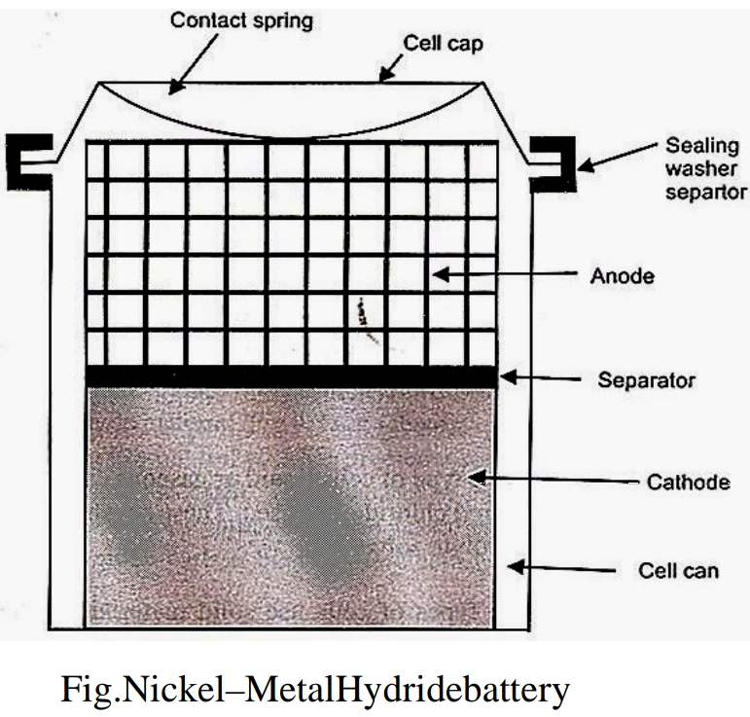
Nickel - Metal Hydride (Ni-MH) battery
It is alkaline rechargeable battery

Slide 16
Nickel metal hydride consists of
Anode: Porous nickel grid pasted with hydrides of metals like VH₂, ZrH₂ and TiH₂ with hydrogen storage metal alloy such as TiNi₂ or LaNi₅.
Cathode: Porous nickel grid pasted with nickel oxy hydroxide (NiO(OH)) and Ni(OH)_{2.}
Electrolyte: Aqueous solution of KOH (28%)
Separator: Anode and cathode are separated by polypropylene which acts as a medium for absorbing electrolyte and insulator between two electrodes.
Voltage: 1.3V
Cell representation: MH₂,M/KOH(28%)/,NiO(OH), Ni(OH)₂

Slide 17
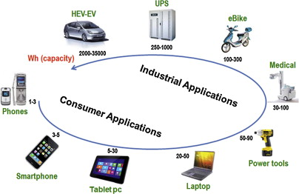
Reactions:
At anode: MH₂ + 2OH⁻ → M + H₂O + 2e⁻
At cathode: 2NiO(OH) + 2 H₂O + 2 e⁻ → 2 Ni(OH)₂ +2OH⁻
Net cell reaction: MH₂ + 2NiO(OH) → M + 2Ni(OH)₂
During charging cell reactions will be reversed. The potential of the cell is 1.3 V having high capacity, long life and rapid recharge capacity.
Applications:
Used in cellular phones, laptop computers, electric vehicles and space crafts.

Slide 18
Lithium-MnO₂ battery
The anode: lithium metal
The cathode: MnO₂ (Heat treated at 350 ⁰C)
The electrolyte: Lithium salt (LiCl, LiClO₄, LiBr, LiAlCl_{4,} or LiCF₃SO₃) dissolved in a mixed organic solvent of propylene carbonate and 1,2- dimethoxy ethane.
(water is not used as a solvent because lithium is highly reactive in water, whereas rate of corrosion of Li is slow in organic solvents)
The anode and cathode are separated by a non woven polypropylene separator.
Cell representation:
Li|Li+| Lithium salt of organic solvent| Mn(IV)O₂|Mn(III)O₂

Slide 19
Reactions:
Anode: Li → Li⁺ + e⁻
Cathode: Mn(IV)O₂ →Mn(III)O₂ (Li⁺)
Overall reaction: Li + Mn(IV)O₂ → Mn(III)O₂ (Li⁺)
At anode, oxidation of lithium takes place producing Li⁺ ions.
Li⁺ ions move into the electrolyte and electrons move into the electrolyte and electrons move into the external circuit to reach the cathode.
At Cathode, MnO₂ is reduced from +4 oxidation state to +3 state to give LiMnO₂

Slide 20
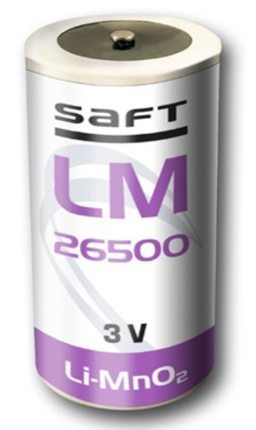
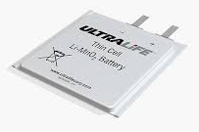
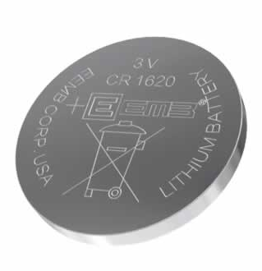


Applications: it is used in electric watches, calculators, automatic cameras, toys and many consumer electronic devices

Slide 21
Lithium ion battery
Rechargeable, Lithium ion batteries possesses many advantages.
They include-high voltage, high energy density (240 Whr/kg), high cycle life and very low self-discharge when not in use.
It provides maximum voltage of 3.7V
Anode: Graphite carbon.
Cathode: Lithium-metal oxide (Li-MO₂), where M is Co or Mn.
Electrolyte: LiPF₆ (Lithium hexaflurophosphate) in a mixture of organic solvent like ethylene carbonate and dimethyl carbonate.
Cell representation:
Li | Li⁺, C |LiPF₆ in ethylene carbonate | Li-MO₂

Slide 22
Cathode : Li atoms insert
in the layered structure of MO₂
Anode : Li atoms insert
in the layered graphite
Li
Li
Li⁺
Li
Li
Li⁺
Li⁺
Li⁺
Li
Li
Li
Li
Discharging
Li
Li
Li
Li
Li
Li
charging
Li
Li
Li
Li⁺
Li⁺
Li⁺
Li⁺
Li
Li
LiPF₆ electrolyte in organic solvent

Slide 23
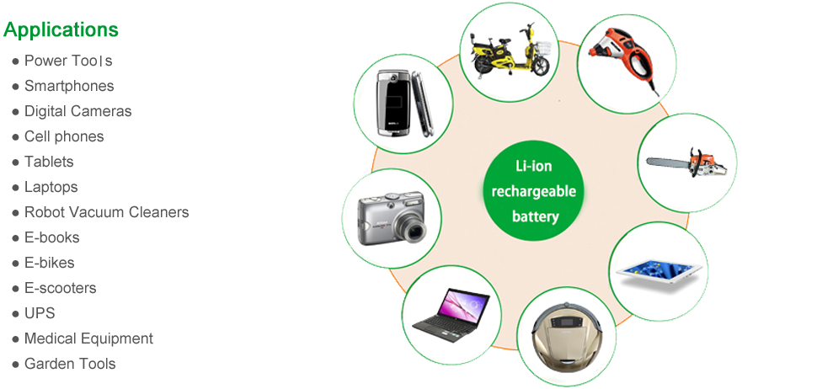
Electrode reaction during discharging
At anode: Li-C₆ → Li⁺ + e⁻ + 6C
At cathode: Li ⁺ + e⁻ + MO₂ → LiMO₂
Net cell reaction: Li-C₆ + MO₂ → 6C + LiMO₂
During charging cell reactions will be reversed.
Applications:
cell phones
laptops
Electric vehicles

Slide 24
Thank You

